Slide 1
Amazon Books Rating prediction & Recommendation Model
CIS 5560 - Term Project
Group 3

Slide 2
Team Members
YOUGENDER CHAUHAN
NAGENDER CHAUHAN
SUMAN CHAUHAN
HSIU-PING
LIN

Slide 3
Data Source URLs
Dataset URL(2.9 GB):
GitHub Dataset URL:
GitHub URL:
https://www.kaggle.com/datasets/mohamedbakhet/amazon-books-reviews?select=Books_rating.csv
https://github.com/Chauhan67/Amazonbookreviews/releases/download/v1/amazonbooks.zip
https://github.com/Chauhan67/Amazon-Books-rating-prediction-and-recomendation-cluster

Slide 4
SPECIFICATIONS
01
02
03
04
Memory Size
Number of Nodes
Cluster Version:
Hadoop 3.1.2
Spark 3.0.2
CPU Speed:
1995.3 MHz, 4 core CPU
Command:
$hdfs dfs -df -h
Command:
$yarn node -list -all
Command:
$hdfs version
$pyspark –version
Command: $lscpu

Slide 5
Why Amazon?
Amazon.com is originally found by Jeff Bezos in 1994 and has grown rapidly to become one of the most successful e-commerce businesses in the world.
With a rapid rate, Amazon.com has expanded in the world and has become one of the most popular retailing website in the world. The success is mainly due to its customer friendly website interface and innovative tools that aid the customers such as providing lists of best sellers, popular books and the recommendation system.
Reviews are generated in the corresponding product when the customers leave their feedback and rating on the website.

Slide 6
Project Scope
Predict amazon book ratings column using various Pyspark Machine Learning Models.
Use Hyper-parameters and parameters tuning.
Use CrossValidation and TrainValidationSplit.
Comparing difference between Multiclass and Binary Classification.
Build a Recommendation Model.

Slide 7
Architecture
Data Source
Data & Feature Engineering
Data Modelling
Data Validation
(Kaggle)
(Databricks, Zeppelin, Spark CLI, Vectorassemblers, Indexers, Pipeline, Hadoop HDFS
(Using Pyspark ML lib & tuning parameters with CrossValidation & TrainValidationSplit, etc
(Using binary & multiclass evaluation, estimators feature importance)

Slide 8
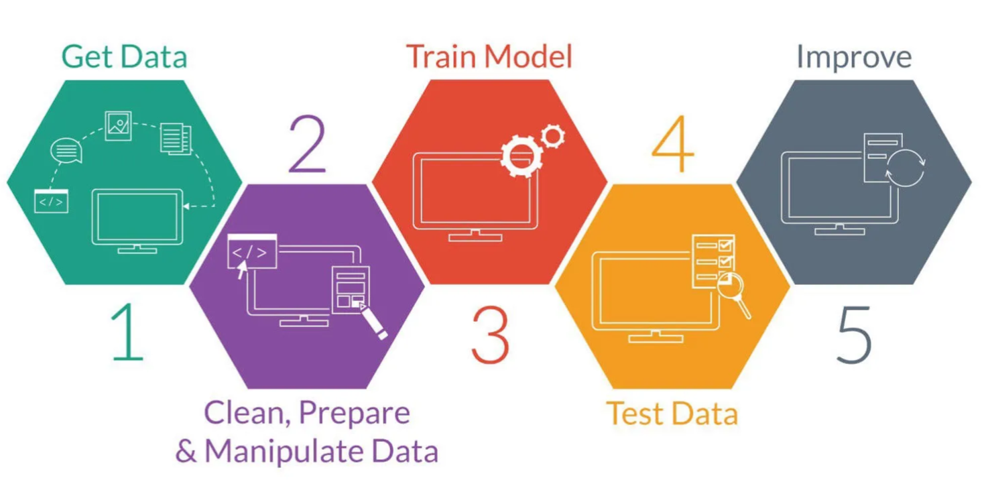
Machine Learning workflow

Slide 9
Flow Chart
Data & Feature Engineering
Train, Test & Validate
Evaluate
Gathering Data
Data Split
Identify project object & look for data sources
Split the data and prepare to train the model
Evaluate models by using measures for accuracy
Preparing the data for modelling
Train, Test & Validate the model

Slide 10
Machine Learning Algorithms used
Multiclass Classification:
Logistic Regression
Random Forest
Decision Tree
Binary Classification
GBT Classifier
Linear SVC
Logistic Regression
Recommendation Model
Alternating least squares collaborative filtering (ALS)

Slide 11
Hyper Parameter & Tuning
Creating a pipeline consisting of StringIndexer, VectorAssembler, VectorIndexer, MinMaxScaler, Tokenizer, StopWordsRemover, Count, Vectorizer, Idf. To convert string and continuous values and normalize
Using ParamGrid builder adding and tuning hyper parameters such as maxIter, regParam, maxBins, maxDepth, impurity, numTrees
TrainValidationSplit & CrossValidation

Slide 12
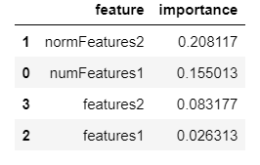
Feature Importance
normFeatures2
normFeatures1
features2
features1
0 0.1 0.2 0.3
It’s the normalized column of ‘Price’
0.20
It’s the normalized column of ‘review/time’
0.15
IDF of ‘review/summary’
0.08
IDF of ‘review/text
0.02

Slide 13
Comparing Models (Multiclass classification)
Model Name | Accuracy | Precision | Recall | F1 | Time
Decision Tree-tvs | 0.63 | 0.57 | 0.63 | 0.53 | 4.7h
Random Forest-tvs | 0.61 | 0.37 | 0.61 | 0.46 | 1.6h
Logistic Regression-tvs | 0.64 | 0.58 | 0.64 | 0.59 | 44m
Decision Tree-cv | 0.58 | 0.50 | 0.058 | 0.48 | 6.9h
Random Forest-cv | 0.58 | 0.55 | 0.58 | 0.43 | 2.2h
Logistic Regression-cv | 0.58 | 0.52 | 0.58 | 0.53 | 1.1h

Slide 14
Comparing Models(Binary Classification)
Model Name | Accuracy | Precision | Recall | F1 | Time
GBT Classifier-tsv | 0.82 | 0.83 | 0.82 | 0.75 | 26h
Linear SVC-tsv | 0.88 | 0.85 | 0.88 | 0.86 | 50m
Logistic Regression-tsv | 0.85 | 0.84 | 0.85 | 0.83 | 48m
GBT Classifier-cv | 0.79 | 0.80 | 0.79 | 0.73 | 30h
Linear SVC-cv | 0.8 | 0.77 | 0.8 | 0.75 | 1.1h
Logistic Regression-cv | 0.79 | 0.76 | 0.79 | 0.76 | 1h

Slide 15
Recommendation Model
Model | RMSE | R2
ALS | 1.1 | -1.2
ALS Implicit | 2.2 | -10.6

Slide 16
Conclusion
After comparing all the models,
For Multiclass Classification
Logistic Regression with tvs
For Binary Classification
LinearSVC with tsv
These are the best fit models with least
Computation time and highest accuracy.

Slide 17
ANY QUESTIONS?

Slide 18
THANK
YOU

